Slide 1
File Handling
Files are named locations on disk to store related information. They are used to permanently store data in a non-volatile memory (e.g. hard disk).
Since Random Access Memory (RAM) is volatile (which loses its data when the computer is turned off), we use files for future use of the data by permanently storing them.
When we want to read from or write to a file, we need to open it first. When we are done, it needs to be closed so that the resources that are tied with the file are freed.
Hence, in Python, a file operation takes place in the following order:
Open a file
Read or write (perform operation)
Close the file
File_object = open(r"File_Name", "Access_Mode")

Slide 2
Opening a file
Opening a file refers to getting the file ready either for reading or for writing. This can be done using the open() function.
This function returns a file object and takes two arguments, one that accepts the file name and another that accepts the mode(Access Mode).
The r is placed before filename to prevent the characters in filename string to be treated as special character. For example, if there is \temp in the file address, then \t is treated as the tab character and error is raised of invalid address. The r makes the string raw, that is, it tells that the string is without any special characters.
The syntax being: open(filename, mode).
“ r “, for reading.
“ w “, for writing.
“ a “, for appending.
“ r+ “, for both reading and writing

Slide 3
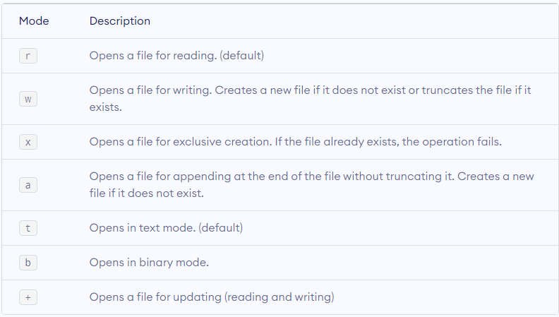
mode

Slide 4
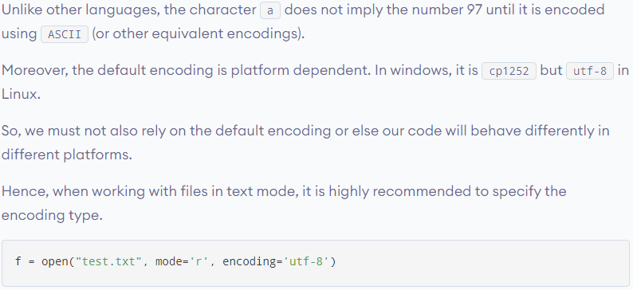

Slide 5
Read data from a text file
There are three ways to read data from a text file.
read() : Returns the read bytes in form of a string. Reads n bytes, if no n specified, reads the entire file.
File_object.read([n])
readline() : Reads a line of the file and returns in form of a string.For specified n, reads at most n bytes. However, does not reads more than one line, even if n exceeds the length of the line.
File_object.readline([n])
readlines() : Reads all the lines and return them as each line a string element in a list.
File_object.readlines()

Slide 6
We can see that the read() method returns a newline as '\n'. Once the end of the file is reached, we get an empty string on further reading.
We can change our current file cursor (position) using the seek() method. Similarly, the tell() method returns our current position (in number of bytes).

Slide 7
The best way to close a file is by using the with statement. This ensures that the file is closed when the block inside the with statement is exited.
We don't need to explicitly call the close() method. It is done internally.
with open("test.txt", encoding = 'utf-8') as f: # perform file operations

Slide 8
Writing to file
There are two ways to write in a file.
write() : Inserts the string str1 in a single line in the text file.
File_object.write(str1)
writelines() : For a list of string elements, each string is inserted in the text file. Used to insert multiple strings at a single time.
File_object.writelines(L) for L = [str1, str2, str3]

Slide 9
In order to write into a file in Python, we need to open it in write w, append a or exclusive creation x mode.
We need to be careful with the w mode, as it will overwrite into the file if it already exists. Due to this, all the previous data are erased.
Writing a string or sequence of bytes (for binary files) is done using the write() method. This method returns the number of characters written to the file.

Slide 10
Closing a file
When we are done with performing operations on the file, we need to properly close the file.
Closing a file will free up the resources that were tied with the file. It is done using the close() method available in Python.
Python has a garbage collector to clean up unreferenced objects but we must not rely on it to close the file.
This method is not entirely safe. If an exception occurs when we are performing some operation with the file, the code exits without closing the file.
A safer way is to use a try...finally block.

